Slide 1
ROSie
A new robotic platform for the Rosie project
Lizzie Mamantov

Slide 2
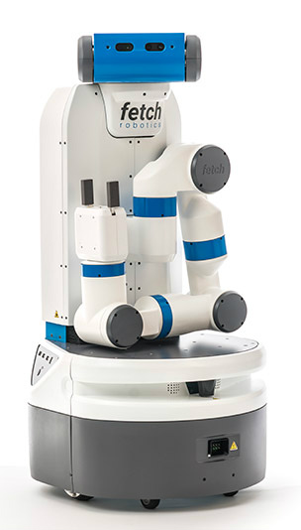
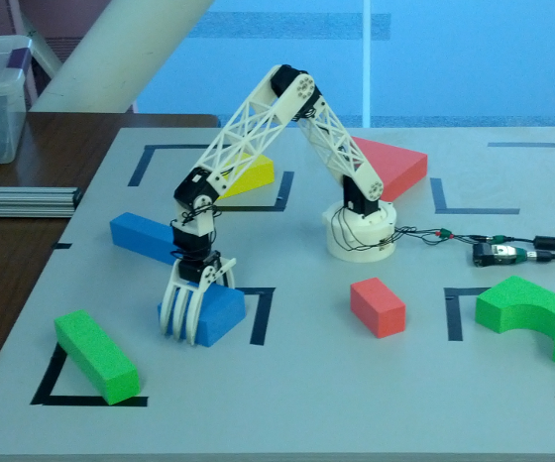
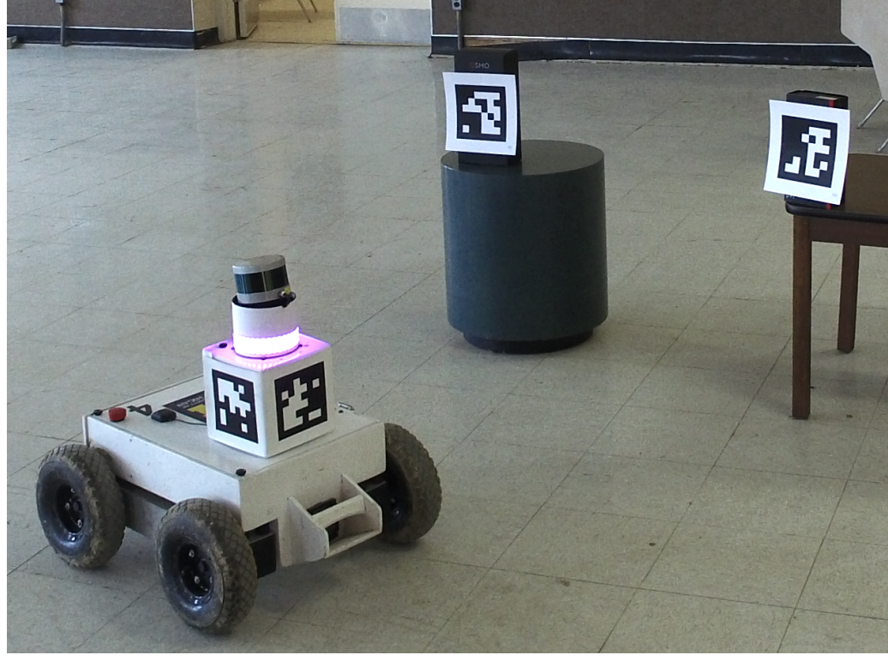
The new face of Rosie
Learns fetching and delivery tasks [Mininger and Laird, ACS 2016]
Learns novel games [Kirk and Laird, ACS 2016]

Slide 3
Roadmap
Fetch details
All about ROS
ROSie system
Future work
Nuggets and coal

Slide 4
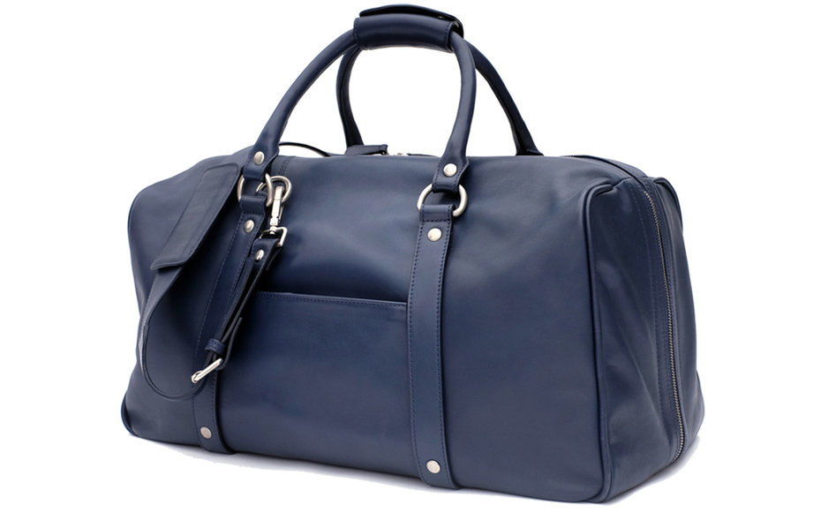
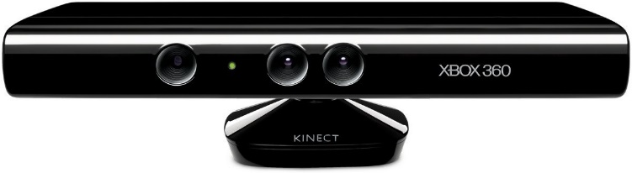
Why Fetch?
Primesense RGB-D sensor
ROS
7 DOF arm
manipulator
mobile
SICK laser range finder

Slide 5
Roadmap
Fetch details
All about ROS
ROSie system
Future work
Nuggets and coal

Slide 6
Robot Operating System (ROS)
ROS… “is a set of software libraries and tools that help you build robot applications. From drivers to state-of-the-art algorithms, and with powerful developer tools, ROS has what you need for your next robotics project. And it's all open source.”
Framework for running software “nodes” and pass messages between nodes
Publish/subscribe model
Also includes:
Tools to monitor node communications
Standard message types
Tools to build and manage packages in ROS ecosystem
Robot description language

Slide 7
ROS pros + cons
Widely used
Makes lots of software available to us
Makes our software usable by others
General, fully-featured simulator
Built-in tools very useful
Works with Fetch (and other platforms)
Does too much
Lots of dependencies
Only compatible with one version of Ubuntu
Not always easy to work with

Slide 8
Roadmap
Fetch details
All about ROS
ROSie system
Future work
Nuggets and coal

Slide 9
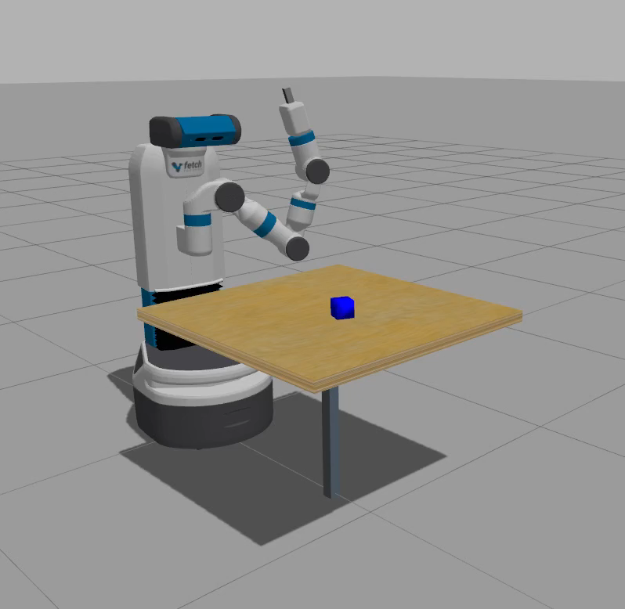
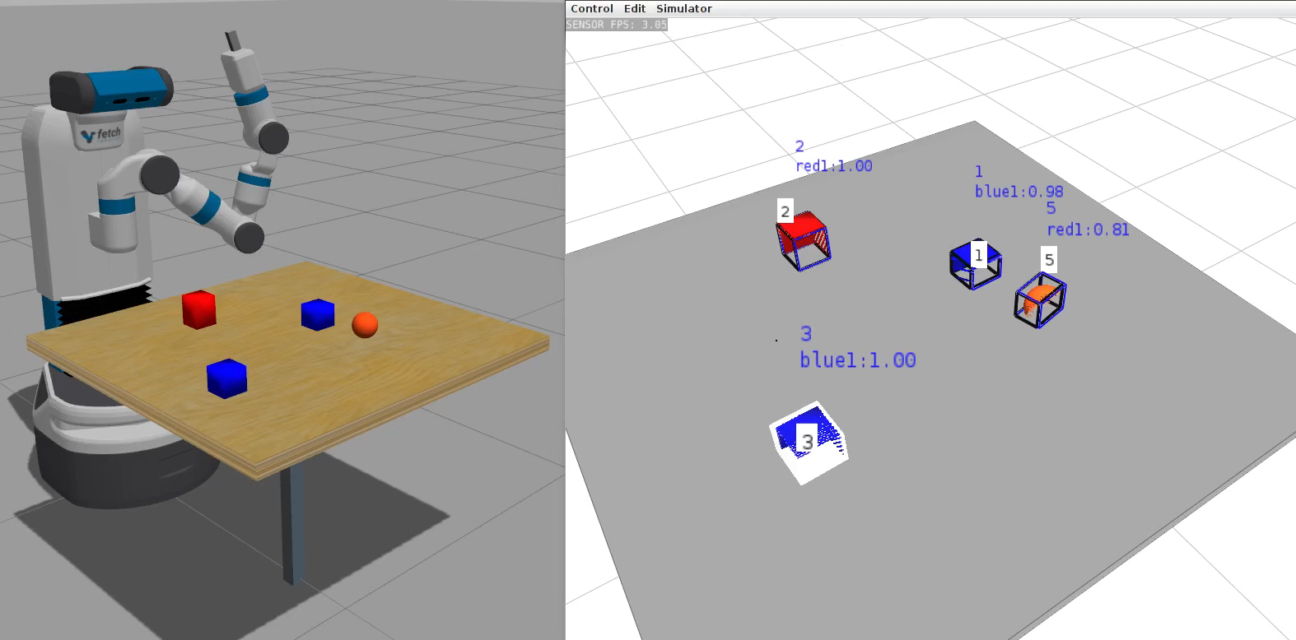
System overview
Soar
input-link
output-link
Segmentation
Rosie motion node
MoveIt!

Slide 10
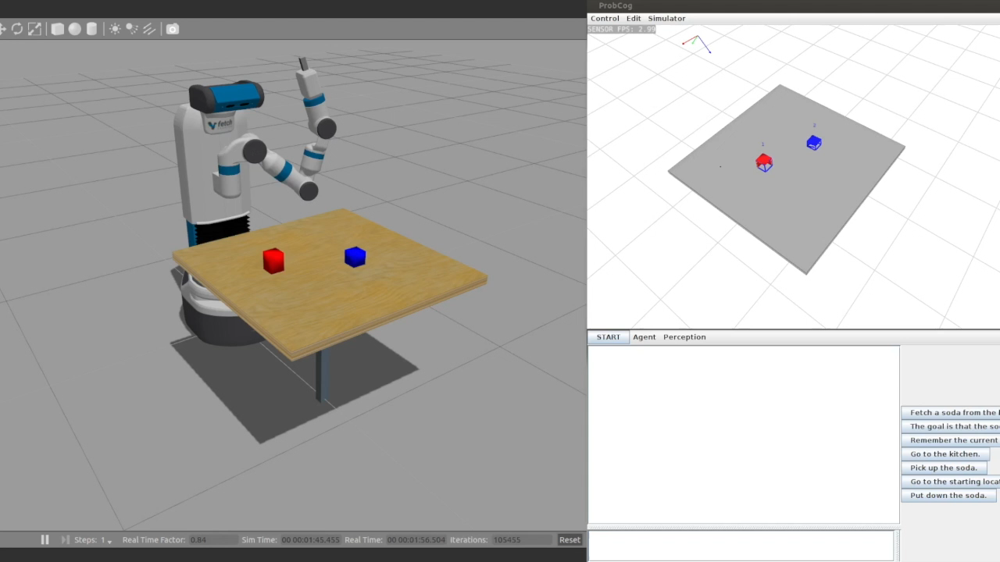
We’re getting there…

Slide 11
Roadmap
Fetch details
All about ROS
ROSie system
Future work
Nuggets and coal

Slide 12
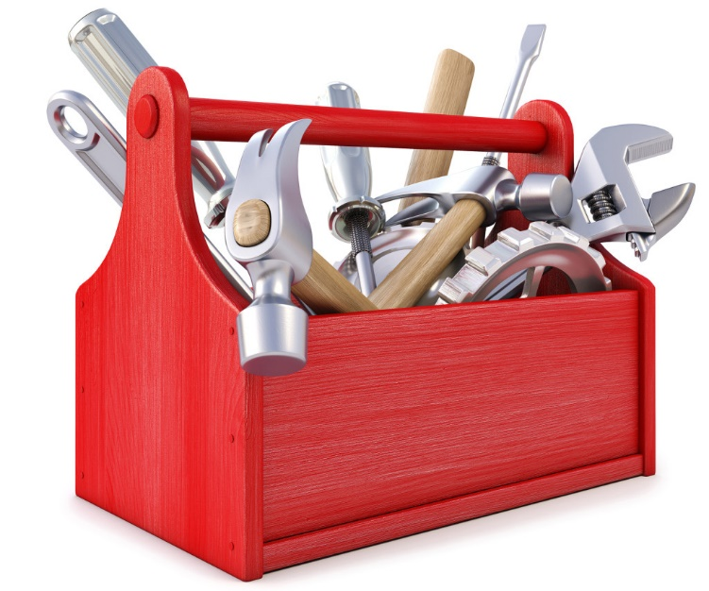
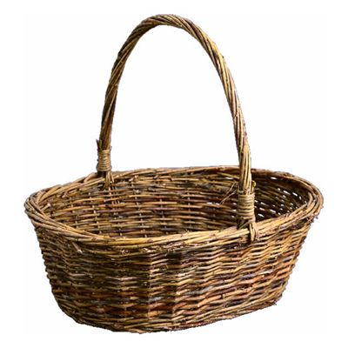

Motor reasoning problem space
Evaluate several motor options from toolbox
Access task knowledge about objects to make these decisions
Move on to other options if one fails
Combine actions to solve one action request
Use unrelated objects to solve request if needed
?
?
?
?
Chips are crushable

Slide 13
Roadmap
Fetch details
All about ROS
ROSie system
Future work
Nuggets and coal

Slide 14
Nuggets + coal
Capable new platform
Existing Rosie tabletop pipeline replicated
Beginning testing on real robot
Sets up motor toolbox
Using ROS
Lots of new dependencies
Mobile tasks not added in yet
Motor toolbox needs to be implemented
Using ROS

